Slide 1
Autonomous Mobile Robots
Control and Planning: Autonomous Mobile Robots and Autonomous Vehicles
Aliasghar Moj Arab

Slide 2
Lecture 3
P A R T 0 1
Control & Perception Fundamentals

Slide 3
Topics
Introduction & Physical Constraints
Vehicle Kinematics & Equations of Motion
Control & Perception Fundamentals
Nonlinear Control Methods
Advanced Model Predictive Control (NMPC) + Constraints
Motion Planning Algorithms (RRT*, RRT, DWA, path generation)
Learning-Based Planning & Control
Industry Standards, Architectures, & Safety

Slide 4
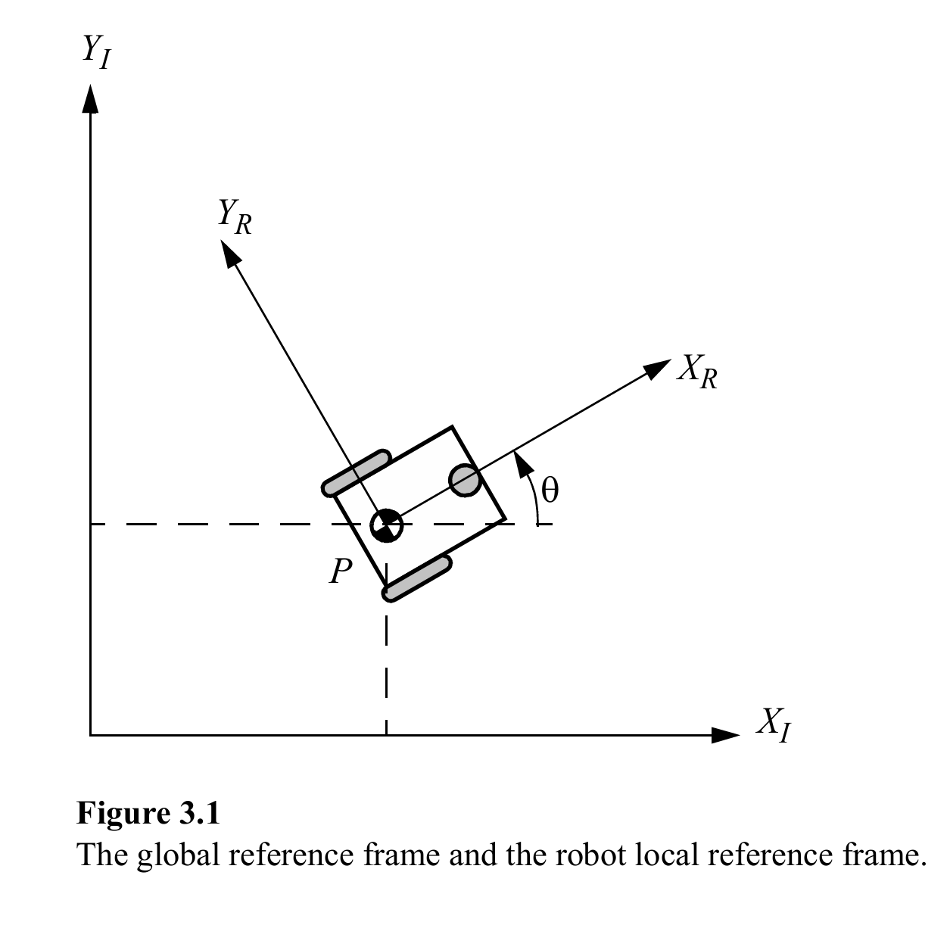
Recap: Differential Drive Kinematics
Robot has 2 wheels
Radius: r
Distance between wheels: 2b
Robot body velocities:
vₓ = (r/2)(φ̇₁ + φ̇₂)
ω = (r/2b)(φ̇₁ − φ̇₂)
v_{y} = 0
Wheel speeds: φ̇₁(right wheel) φ̇₂ (left wheel)
Nonholonomic constraint:
No lateral velocity (v_{y} = 0)
Introduction to Autonomous Mobile Robots
second edition
Roland Siegwart, Illah R. Nourbakhsh, and Davide Scaramuzza

Slide 5

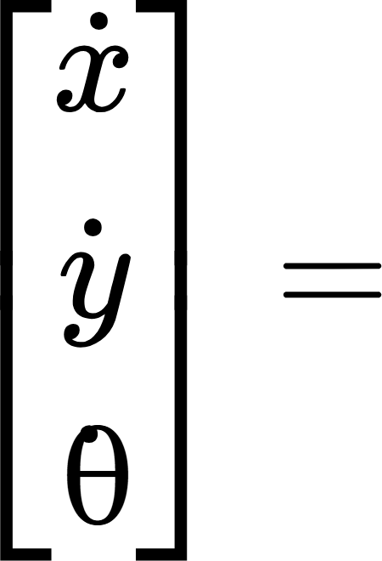
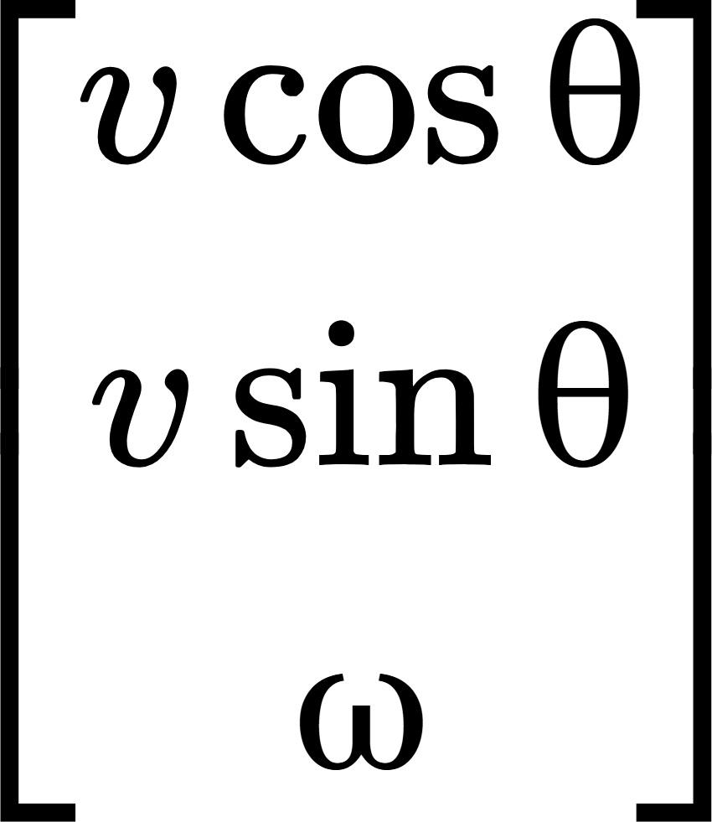
State-Space Kinematics
Robot’s pose:
X =
Motion equations (global frame)
Introduction to Autonomous Mobile Robots
second edition
Roland Siegwart, Illah R. Nourbakhsh, and Davide Scaramuzza
Compact form: ẋ = f(x, u)

Slide 6
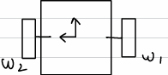
Dynamics (General EoM)
General dynamic model:
M(q)·q̈ + C(q, q̇)·q̇ + G(q) = B_{x}(q)·F_{x} + B_{y}·F_{y}
M(q): Mass / inertia matrix
C(q, q̇): Coriolis / centrifugal effects
G(q): Gravity or extra forces
F_{x}, F_{y}: Wheel forces

Slide 7
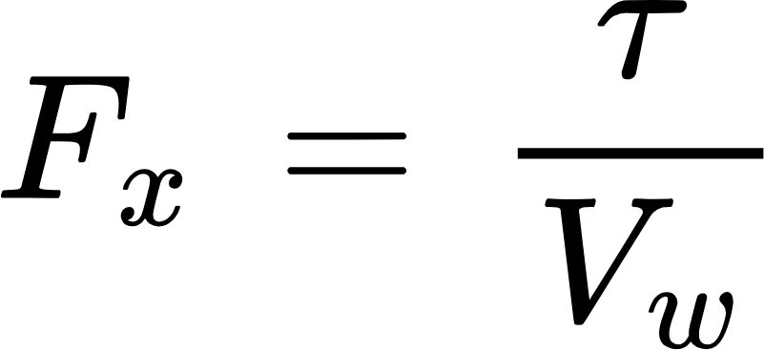
Assumptions
No Slipping (Longitudinal):
r φ̇ = V_{wx}
No Sliding (Latitudinal):
V_{wy} = 0
F_{y} = 0

Slide 8
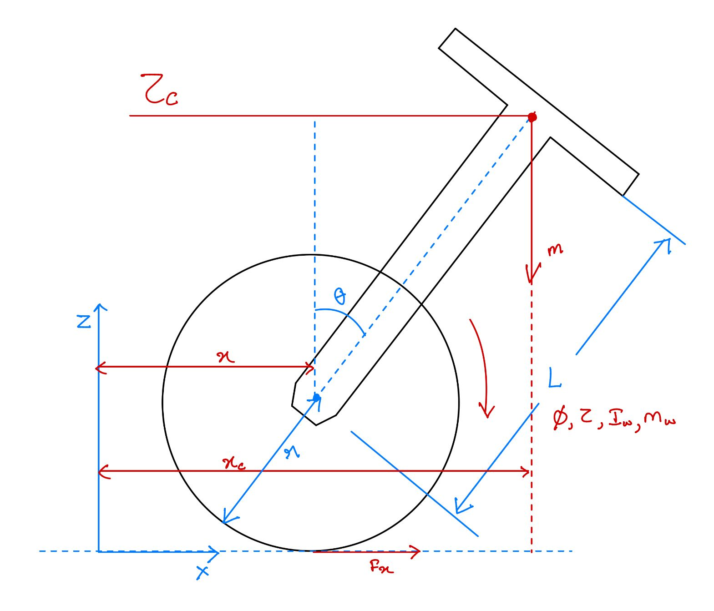
One-Wheeled Balancing Robot
Wheel radius = r , Body length = L, Mass = m
States:
ϕ = wheel angle
θ = body tilt (from vertical)
Position:
x = rϕ
x_{c} = x + L sin θ
z_{c}​ = L cos θ + r

Slide 9
Energies & Lagrangian
Kinetic Energy:
Potential Energy:
V = m g ( r + L cos θ ) - m g (r + L ) = m g L (cos θ − 1)
Lagrangian: L = K - V

Slide 10
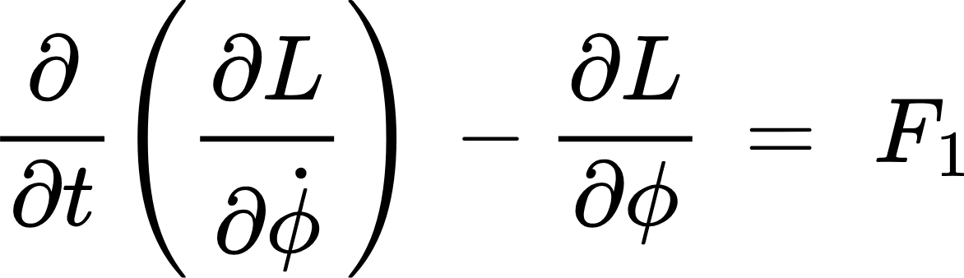
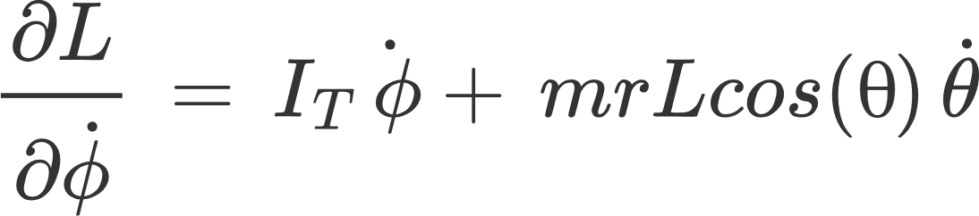
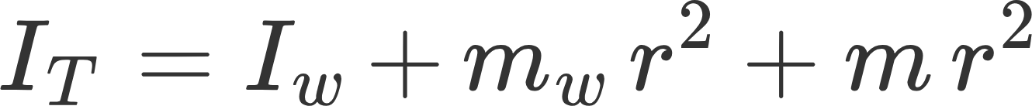
Euler-Lagrange for (ϕ): 1st EOM

Slide 11
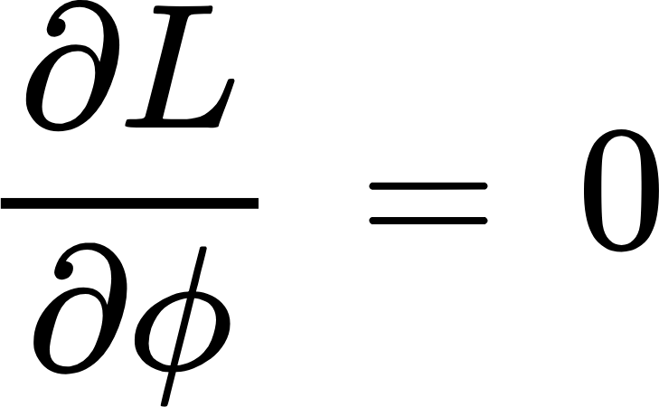
Euler-Lagrange for (ϕ): 1st EOM
First Equation of Motion (EOM-1)

Slide 12
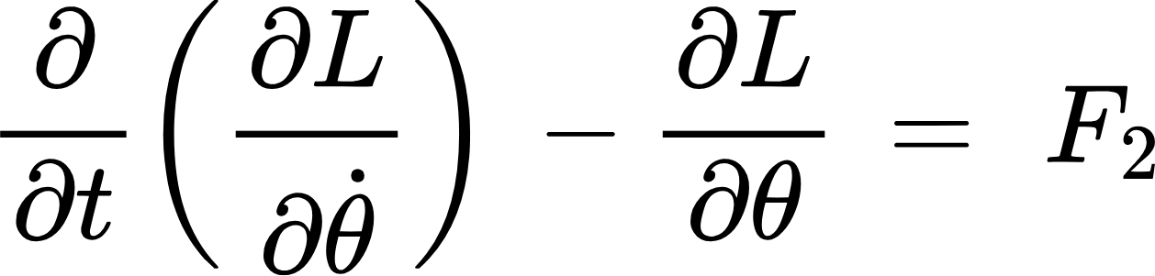
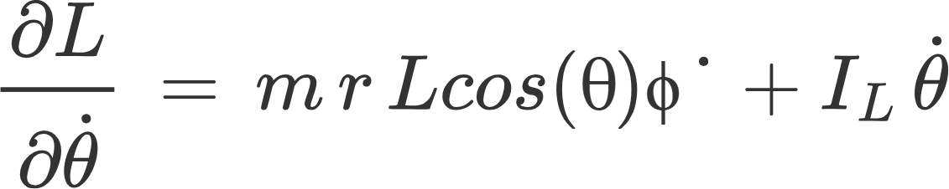
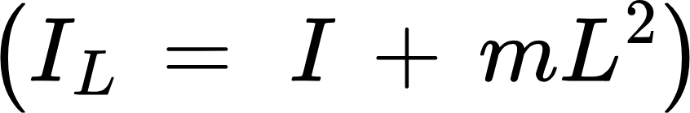
Euler-Lagrange (for θ) : 2nd EOM

Slide 13
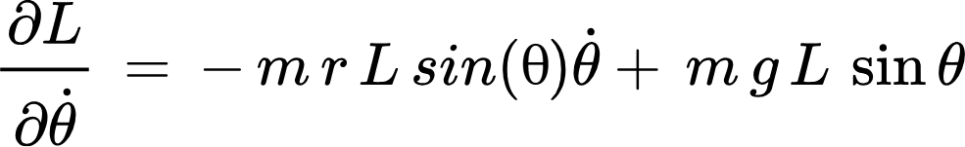
Euler-Lagrange:
2nd EOM

Slide 14
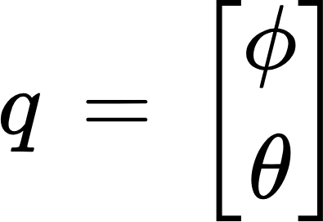
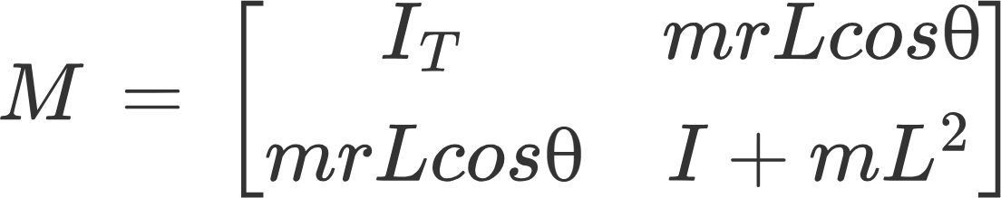
Equations in Matrix Form

Slide 15
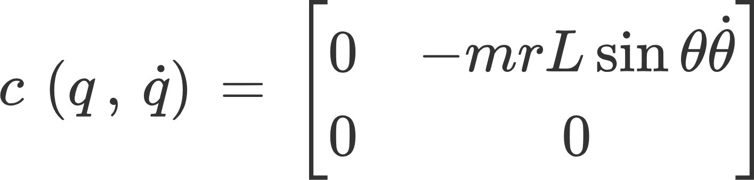
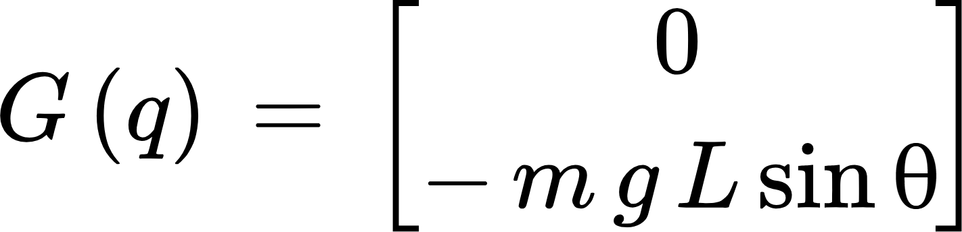
Equations in Matrix Form

Slide 16
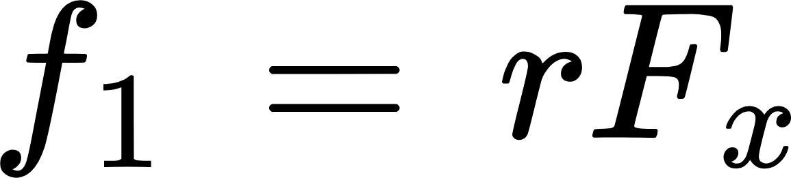
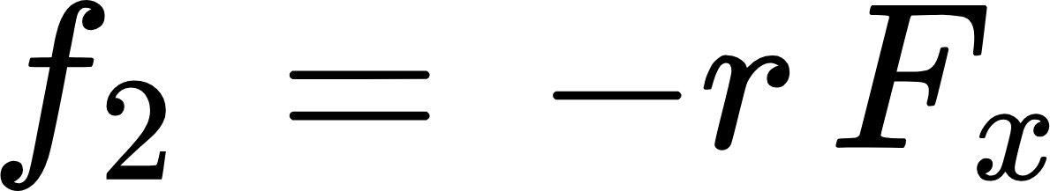
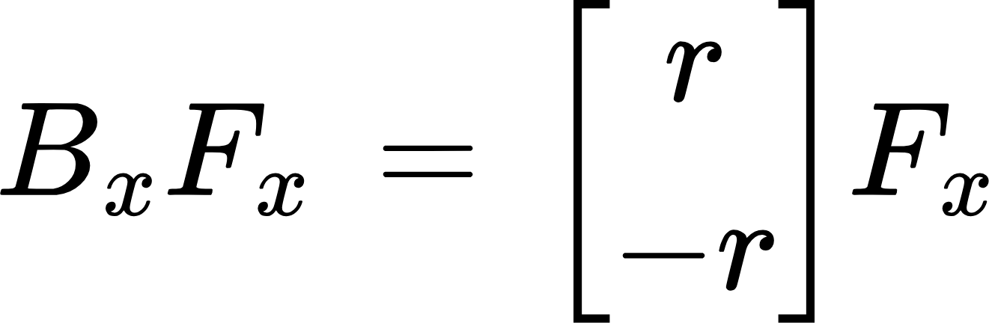
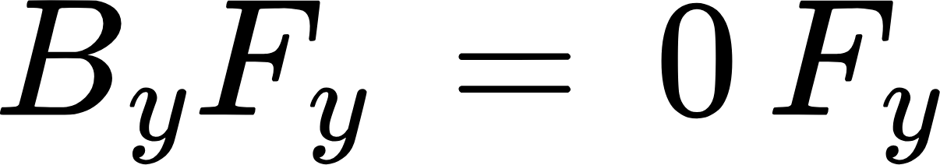
Equations in Matrix Form

Slide 17
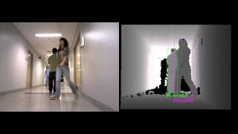
Perception
Dynamics give us motion equations, but we need to know where the robot actually is.
Perception is estimating the robot’s pose relative to the world.

Slide 18
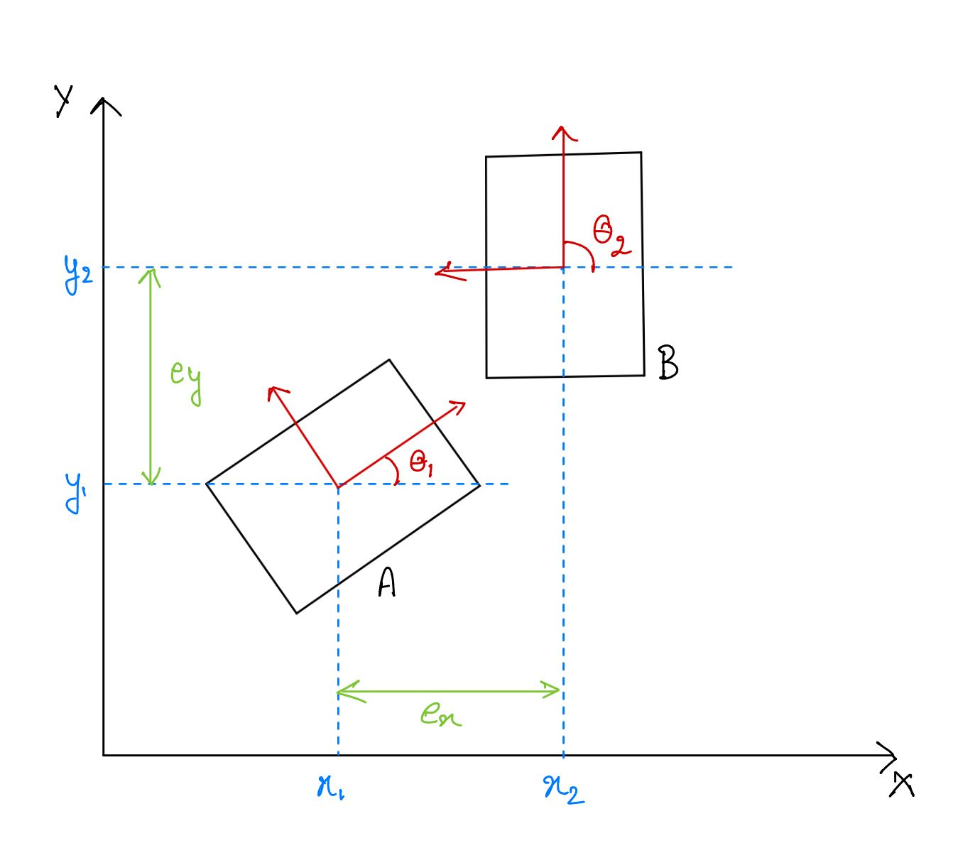
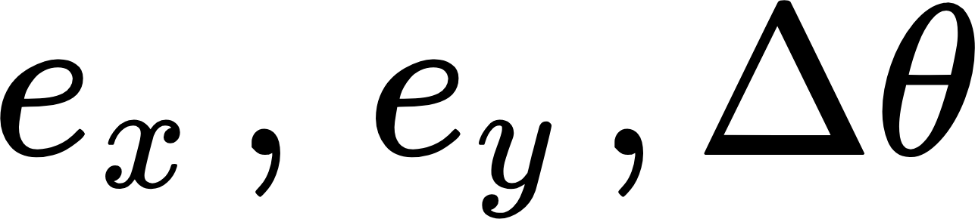
Perception
Example: Robot pose error (A vs. B in figure)
Errors in x, y, and orientation θ.
These represent the mismatch between truth and measured value.

Slide 19
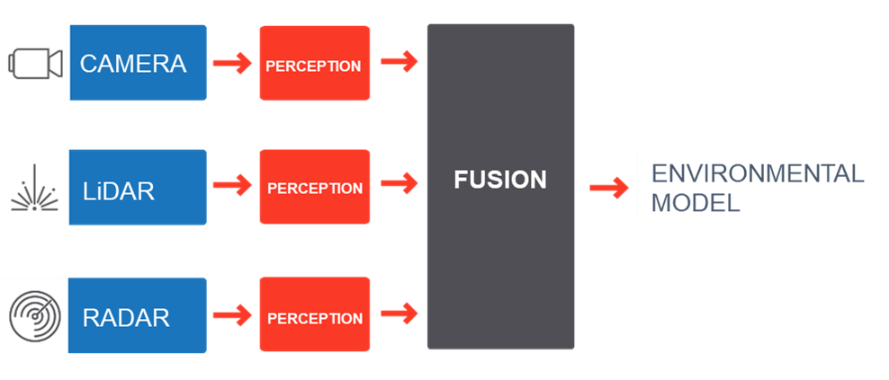
Sensing for Localization
GPS: Global Position (Latitude, Longitude).
Magnetometer: Heading/orientation (absolute).
LiDAR scan matching, global ↔ local alignment, and point cloud matching.
Vision-based camera (features, SLAM).
Combining several sensors for resilience is known as sensor fusion.
https://leddartech.com/app/uploads/2022/03/figure1.png

Slide 20
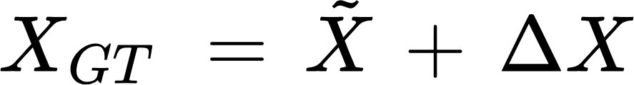

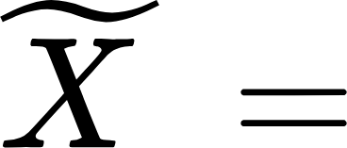

Ground Truth vs Measurement
Ground Truth
Measured Value
Error

Slide 21
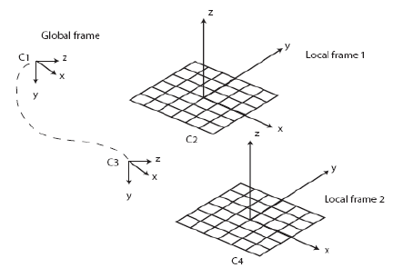
Ground Truth vs Measurement
There’s always a gap between what’s real and what sensors report.
Perception is estimating and correcting this gap.
Local Frame vs Global Frame
https://www.researchgate.net/publication/260297480/figure/fig1/AS:297226145419269@1447875643692/Global-frame-C1-and-local-frame-C2-The-camera-initially-lies-within-C1.png

Slide 22
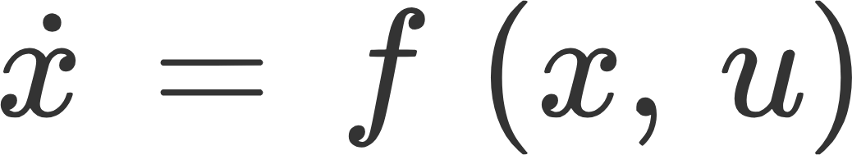
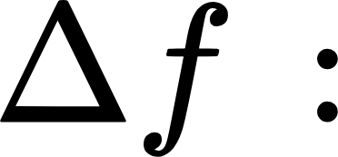
State-Space with Uncertainty
Original Model :
With uncertainties:
models uncertainty due to noise, drift, or environment.

Slide 23
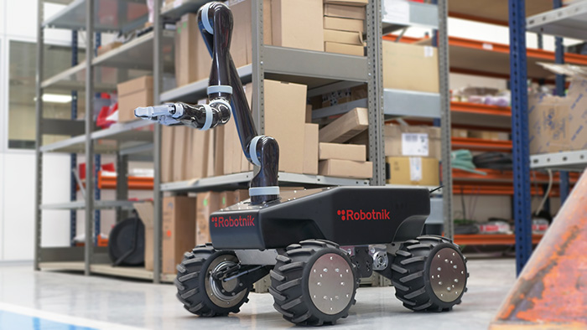
SCARA Actuator on Vehicle
When a manipulator (SCARA arm) is mounted on a vehicle, their dynamics are coupled.
The system must consider both:
Actuator (arm) dynamics.
Vehicle (mobile base) dynamics.
https://robotnik.eu/wp-content/uploads/2022/09/Robotnik_XL-GEN_web_220615_01-1.jpg

Slide 24
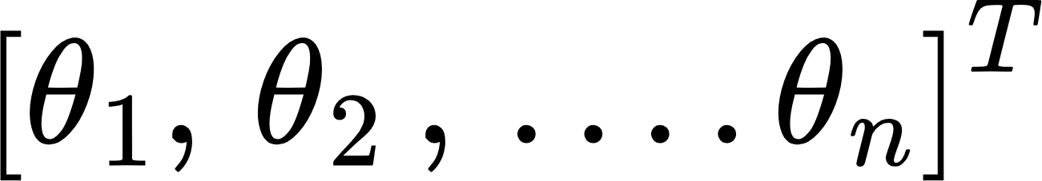
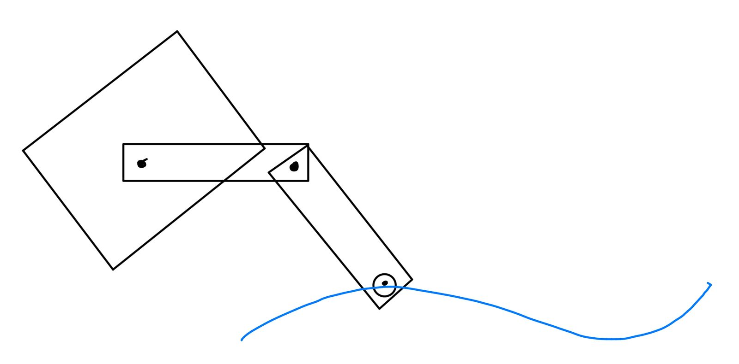
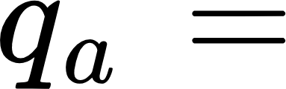


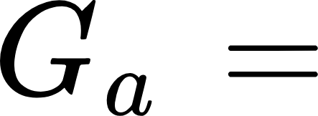
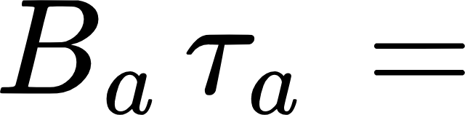
Actuator Dynamics (SCARA arm)
inertia of arm
Coriolis/centrifugal effect
gravity of arm
input torque at joints

Slide 25
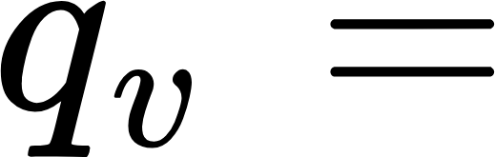
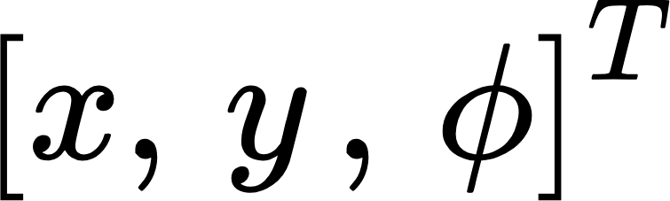


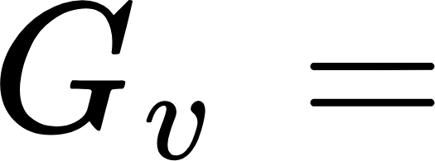
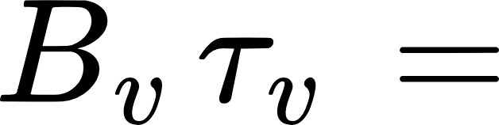
Vehicle Dynamics
inertia of vehicle
Coriolis/centrifugal effect
vehicle’s gravitational effect
driving forces/torques

Slide 26
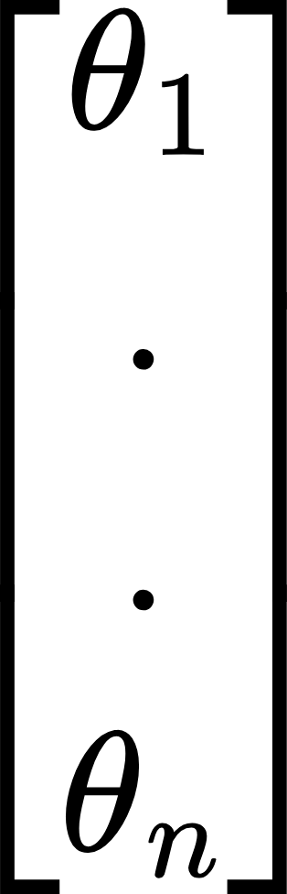
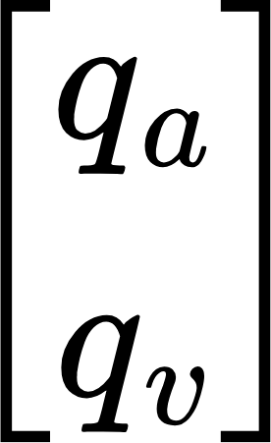

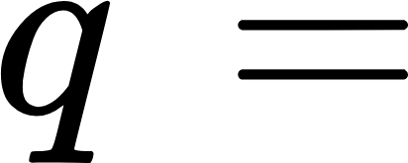
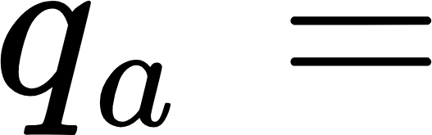

Combined System
Full State Vector
Unified dynamics:

Slide 27
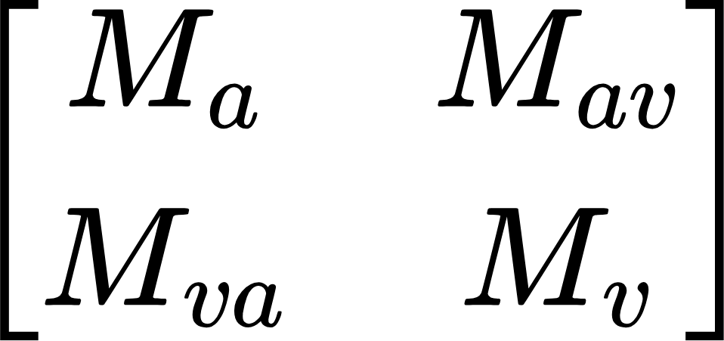

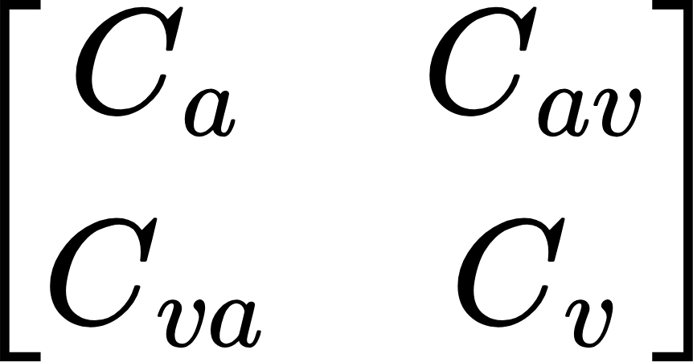

Matrix Structure
Block Matrix form:

Slide 28
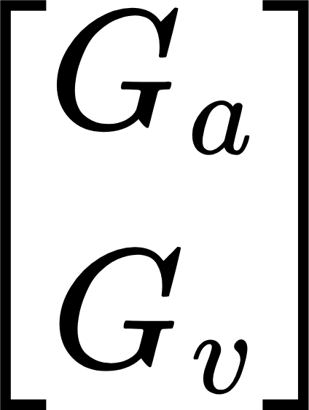
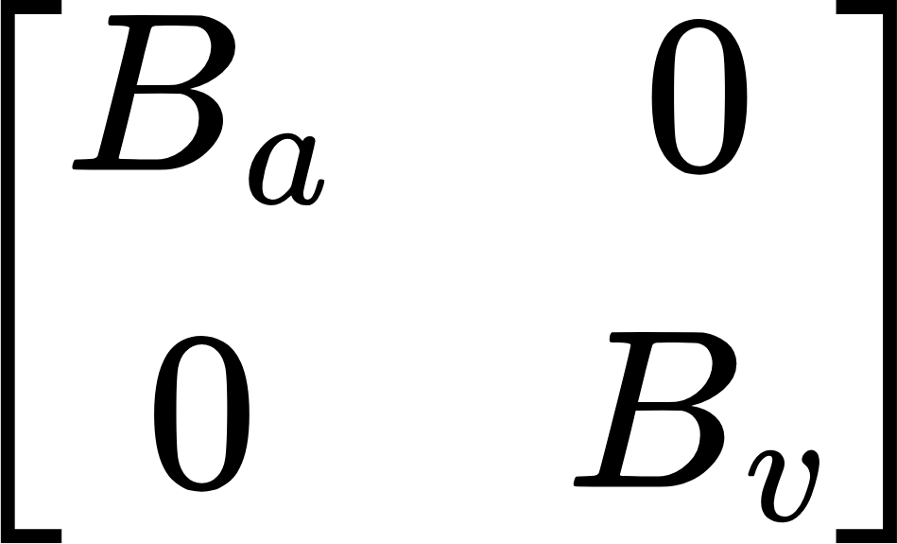



Matrix Structure
Block Matrix form:
coupling terms
Manipulator affects vehicle
Vehicle affects manipulator

Slide 29
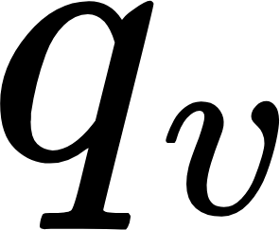
Extension: Mecanum Vehicle
For a 3-wheel or 4-wheel mecanum robot, increases (extra DOFs).
Example: 3×3 gives a 4×4 vehicle inertia matrix.
Same block structure, only dimensions change.
https://robotnik.eu/wp-content/uploads/2022/09/Robotnik_XL-GEN_web_220615_01-1.jpg

Slide 30
Key Points:
Vehicle and manipulator dynamics are not independent.
Must model coupling between them.
This framework generalizes to:
Any manipulator-on-mobile-base system (e.g., robotic arms on AGVs).
https://robotnik.eu/wp-content/uploads/2022/09/Robotnik_XL-GEN_web_220615_01-1.jpg

Slide 31



Coordinate Transformation of Mobile Robot Dynamics
Differential Drive
Defining Look Ahead Point
Velocity Relation:

Slide 32

Coordinate Transformation of Mobile Robot Dynamics
Dynamics at Y :
Link to Generalised Velocities:

Slide 33
Coordinate Transformation of Mobile Robot Dynamics
Linking to Generalized Velocities
Dynamics at Y :

Slide 34







Coordinate Transformation of Mobile Robot Dynamics
Defining Barred Matrices

Slide 35
Coordinate Transformation of Mobile Robot Dynamics
Final Dynamics

Slide 36

4-Independent wheel drive (swerve mechanism)
4-Independent Wheeled Drive (Swerve)
Each wheel has 2 actuations:
Steering angle δ_{i}
Driving force F_{i}
Robot motion = combined effect of all 4 wheels.

Slide 37
4-Independent wheel drive (swerve mechanism)
Force Balance in x:
Force Balance in y

Slide 38

Torque Balance (Yaw Motion)

Slide 39
HW: Simulation / Validation
Example simulation: Duration: 10 s Step size: Δt = 0.01
Goal: Verify that the simulated path matches expectations.Straight line, circle, etc.
Using a simple numerical update:
x(t + Δt) = x(t) + ẋ(t)·Δt
Using Matlab, Simulink, Python

